Slide 1
Thinking Like an Economist
© 2015 Cengage Learning. All Rights Reserved. May not be copied, scanned, or duplicated, in whole or in part, except for use as permitted in a license distributed with a certain product or service or otherwise on a password-protected website for classroom use.

Slide 2
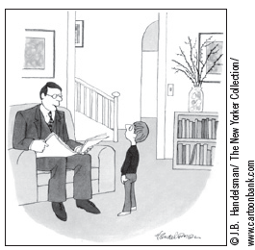
The Economist as a Scientist
Economics
  Science
Economists
  Scientists
    Devise theories
    Collect data
    Analyze these data
      Verify or refute their theories
“I’m a social scientist, Michael. That means I can’t explain electricity or anything like that, but if you ever want to know about people, I’m your man.”
© 2015 Cengage Learning. All Rights Reserved. May not be copied, scanned, or duplicated, in whole or in part, except for use as permitted in a license distributed with a certain product or service or otherwise on a password-protected website for classroom use.

Slide 3
The Economist as a Scientist
Scientific method
  Dispassionate development and testing of theories about how the world works
  Observation, theory, more observation
Conducting experiments in economics
  Is often impractical
Substitute for laboratory experiments
  Economists pay close attention to the natural experiments offered by history
© 2015 Cengage Learning. All Rights Reserved. May not be copied, scanned, or duplicated, in whole or in part, except for use as permitted in a license distributed with a certain product or service or otherwise on a password-protected website for classroom use.

Slide 4
The Economist as a Scientist
The role of assumptions
Assumptions
  Can simplify the complex world
    Make it easier to understand
  The art in scientific thinking: deciding which assumptions to make
Different assumptions
  To answer different questions
  To study short-run or long-run effects
© 2015 Cengage Learning. All Rights Reserved. May not be copied, scanned, or duplicated, in whole or in part, except for use as permitted in a license distributed with a certain product or service or otherwise on a password-protected website for classroom use.

Slide 5
The Economist as a Scientist
Economic models
  Diagrams and equations
  Omit many details
  Allow us to see what’s truly important
  Built with assumptions
  Simplify reality to improve our understanding of it
© 2015 Cengage Learning. All Rights Reserved. May not be copied, scanned, or duplicated, in whole or in part, except for use as permitted in a license distributed with a certain product or service or otherwise on a password-protected website for classroom use.

Slide 6
The Economist as a Scientist
Circular-flow diagram
  Visual model of the economy
  Shows how dollars flow through markets among households and firms
Decision makers
  Firms and Households
Markets
  For gods and services
  For factors of production (inputs)
© 2015 Cengage Learning. All Rights Reserved. May not be copied, scanned, or duplicated, in whole or in part, except for use as permitted in a license distributed with a certain product or service or otherwise on a password-protected website for classroom use.

Slide 7
The Economist as a Scientist
Firms
  Produce goods and services
  Use factors of production (inputs)
Households
  Own factors of production
  Consume goods and services
© 2015 Cengage Learning. All Rights Reserved. May not be copied, scanned, or duplicated, in whole or in part, except for use as permitted in a license distributed with a certain product or service or otherwise on a password-protected website for classroom use.

Slide 8
The Economist as a Scientist
Firms and Households interact in markets
Markets for goods and services
  Firms are sellers
  Households are buyers
Markets for factors of production
  Firms are buyers
  Households are sellers
© 2015 Cengage Learning. All Rights Reserved. May not be copied, scanned, or duplicated, in whole or in part, except for use as permitted in a license distributed with a certain product or service or otherwise on a password-protected website for classroom use.

Slide 9
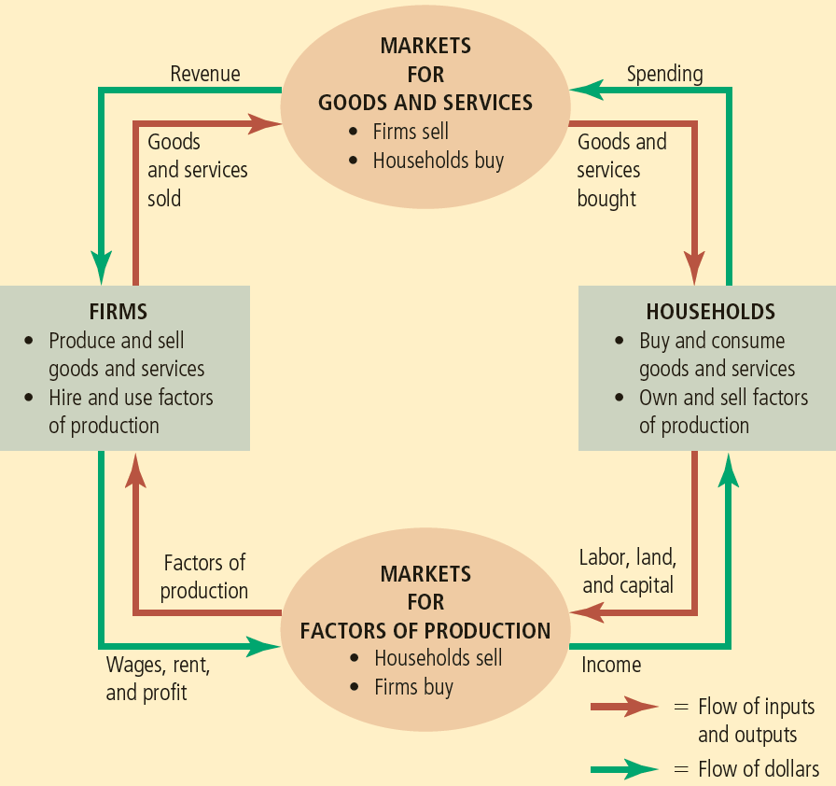
Figure 1
The circular flow
This diagram is a schematic representation of the organization of the economy. Decisions are made by households and firms. Households and firms interact in the markets for goods and services (where households are buyers and firms are sellers) and in the markets for the factors of production (where firms are buyers and households are sellers). The outer set of arrows shows the flow of dollars, and the inner set of arrows shows the corresponding flow of inputs and outputs.
© 2015 Cengage Learning. All Rights Reserved. May not be copied, scanned, or duplicated, in whole or in part, except for use as permitted in a license distributed with a certain product or service or otherwise on a password-protected website for classroom use.

Slide 10
The Economist as a Scientist
Production possibilities frontier
  A graph
  Combinations of output that the economy can possibly produce
  Given the available
    Factors of production
    Production technology
© 2015 Cengage Learning. All Rights Reserved. May not be copied, scanned, or duplicated, in whole or in part, except for use as permitted in a license distributed with a certain product or service or otherwise on a password-protected website for classroom use.

Slide 11
Figure 2
The production possibilities frontier
The production possibilities frontier shows the combinations of output—in this case, cars and computers—that the economy can possibly produce. The economy can produce any combination on or inside the frontier. Points outside the frontier are not feasible given the economy’s resources. The slope of the production possibilities frontier measures the opportunity cost of a car in terms of computers. This opportunity cost varies, depending on how much of the two goods the economy is producing.
Quantity of
Computers
Produced
F
C
3,000
Production
Possibilities
Frontier
2,200
A
2,000
B
1,000
D
E
0
300
600
700
1,000
Quantity of
Cars Produced
© 2015 Cengage Learning. All Rights Reserved. May not be copied, scanned, or duplicated, in whole or in part, except for use as permitted in a license distributed with a certain product or service or otherwise on a password-protected website for classroom use.

Slide 12
The Economist as a Scientist
Efficient levels of production
  The economy is getting all it can from the scarce resources available
  Points on the production possibilities frontier
  Trade-off:
    The only way to produce more of one good
    Is to produce less of the other good
© 2015 Cengage Learning. All Rights Reserved. May not be copied, scanned, or duplicated, in whole or in part, except for use as permitted in a license distributed with a certain product or service or otherwise on a password-protected website for classroom use.

Slide 13
The Economist as a Scientist
Inefficient levels of production
  Points inside production possibilities frontier
Opportunity cost of producing one good
  Give up producing the other good
  Slope of the production possibilities frontier
© 2015 Cengage Learning. All Rights Reserved. May not be copied, scanned, or duplicated, in whole or in part, except for use as permitted in a license distributed with a certain product or service or otherwise on a password-protected website for classroom use.

Slide 14
The Economist as a Scientist
Bowed outward production possibilities frontier
  Opportunity cost of a car is highest
    When the economy is producing many cars and fewer computers
  Opportunity cost of a car is lower
    When the economy is producing fewer cars and many computers
  Resource specialization
© 2015 Cengage Learning. All Rights Reserved. May not be copied, scanned, or duplicated, in whole or in part, except for use as permitted in a license distributed with a certain product or service or otherwise on a password-protected website for classroom use.

Slide 15
The Economist as a Scientist
Technological advance
  Outward shift of the production possibilities frontier
  Economic growth
  Produce more of both goods
© 2015 Cengage Learning. All Rights Reserved. May not be copied, scanned, or duplicated, in whole or in part, except for use as permitted in a license distributed with a certain product or service or otherwise on a password-protected website for classroom use.

Slide 16
Figure 3
A shift in the production possibilities frontier
Quantity of
Computers
Produced
A technological advance in the computer industry enables the economy to produce more computers for any given number of cars. As a result, the production possibilities frontier shifts outward. If the economy moves from point A to point G, then the production of both cars and computers increases.
4,000
3,000
2,300
G
2,200
A
0
600
650
1,000
Quantity of
Cars Produced
© 2015 Cengage Learning. All Rights Reserved. May not be copied, scanned, or duplicated, in whole or in part, except for use as permitted in a license distributed with a certain product or service or otherwise on a password-protected website for classroom use.

Slide 17
The Economist as a Scientist
Microeconomics
  The study of how households and firms make decisions and how they interact in markets
Macroeconomics
  The study of economy-wide phenomena, including inflation, unemployment, and economic growth
© 2015 Cengage Learning. All Rights Reserved. May not be copied, scanned, or duplicated, in whole or in part, except for use as permitted in a license distributed with a certain product or service or otherwise on a password-protected website for classroom use.

Slide 18
The Economist as Policy Adviser
Positive vs. Normative analysis
Positive statements
  Attempt to describe the world as it is
  Descriptive
  Confirm or refute by examining evidence
Normative statements
  Attempt to prescribe how the world should be
  Prescriptive
© 2015 Cengage Learning. All Rights Reserved. May not be copied, scanned, or duplicated, in whole or in part, except for use as permitted in a license distributed with a certain product or service or otherwise on a password-protected website for classroom use.

Slide 19
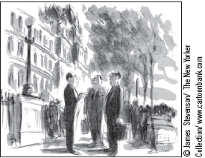
The Economist as Policy Adviser
Economists in Washington
  Council of Economic Advisers
    Advise the president of the United states
    Annual Economic Report of the President
“Let’s switch. I’ll make the policy, you implement it, and he’ll explain it.”
© 2015 Cengage Learning. All Rights Reserved. May not be copied, scanned, or duplicated, in whole or in part, except for use as permitted in a license distributed with a certain product or service or otherwise on a password-protected website for classroom use.

Slide 20
The Economist as Policy Adviser
Economists in Washington
  Office of Management and Budget
  Department of the Treasury
  Department of Labor
  Department of Justice
  Congressional Budget Office
  The Federal Reserve
© 2015 Cengage Learning. All Rights Reserved. May not be copied, scanned, or duplicated, in whole or in part, except for use as permitted in a license distributed with a certain product or service or otherwise on a password-protected website for classroom use.

Slide 21
Why economists’ advice is not always followed
President
  Economic advisers: what policy is best
  Communication advisers: how best to explain it to the public
  Press advisers: how the news media will report
  Legislative affairs advisers: how Congress will view the proposal
  Political advisers: effect on the electorate
  Decision
© 2015 Cengage Learning. All Rights Reserved. May not be copied, scanned, or duplicated, in whole or in part, except for use as permitted in a license distributed with a certain product or service or otherwise on a password-protected website for classroom use.

Slide 22
Why Economists Disagree
Economists may disagree
  Validity of alternative positive theories about how the world works
Economists may have different values
  Different normative views about what policy should try to accomplish
© 2015 Cengage Learning. All Rights Reserved. May not be copied, scanned, or duplicated, in whole or in part, except for use as permitted in a license distributed with a certain product or service or otherwise on a password-protected website for classroom use.

Slide 23
Why Economists Disagree
Differences in scientific judgments
Different hunches about
  Validity of alternative theories
  Size of important parameters
    Measure how economic variables are related
© 2015 Cengage Learning. All Rights Reserved. May not be copied, scanned, or duplicated, in whole or in part, except for use as permitted in a license distributed with a certain product or service or otherwise on a password-protected website for classroom use.

Slide 24
Why Economists Disagree
Differences in values
Peter and Paula - take the same amount of water from the town well
  Peter’s income= $100,000
    Tax= $10,000 (10%)
  Paula’s income= $20,000
    Tax= $4,000 (20%)
© 2015 Cengage Learning. All Rights Reserved. May not be copied, scanned, or duplicated, in whole or in part, except for use as permitted in a license distributed with a certain product or service or otherwise on a password-protected website for classroom use.

Slide 25
Why Economists Disagree
Perception vs. Reality
Rent control
  Adversely affects availability and quality of housing
  Costly way of helping the neediest members of society
  Many cities use rent control
Trade barriers (tariffs and import quotas)
  Economists oppose it
© 2015 Cengage Learning. All Rights Reserved. May not be copied, scanned, or duplicated, in whole or in part, except for use as permitted in a license distributed with a certain product or service or otherwise on a password-protected website for classroom use.

Slide 26
Table 1
Propositions about Which Most Economists Agree
Proposition (and percentage of economists who agree)
1. A ceiling on rents reduces the quantity and quality of housing available. (93%)
2. Tariffs and import quotas usually reduce general economic welfare. (93%)
3. Flexible and floating exchange rates offer an effective international monetary arrangement. (90%)
4. Fiscal policy (e.g., tax cut and/or government expenditure increase) has a significant stimulative impact on a less than fully employed economy. (90%)
5. The United States should not restrict employers from outsourcing work to foreign countries. (90%)
6. Economic growth in developed countries like the United States leads to greater levels of well-being. (88%)
7. The United States should eliminate agricultural subsidies. (85%)
8. An appropriately designed fiscal policy can increase the long-run rate of capital formation. (85%)
© 2015 Cengage Learning. All Rights Reserved. May not be copied, scanned, or duplicated, in whole or in part, except for use as permitted in a license distributed with a certain product or service or otherwise on a password-protected website for classroom use.

Slide 27
Table 2
Propositions about Which Most Economists Agree
9. Local and state governments should eliminate subsidies to professional sports franchises. (85%)
10. If the federal budget is to be balanced, it should be done over the business cycle rather than yearly. (85%)
11. The gap between Social Security funds and expenditures will become unsustainably large within the next 50 years if current policies remain unchanged. (85%)
12. Cash payments increase the welfare of recipients to a greater degree than do transfers-in-kind of equal cash value. (84%)
13. A large federal budget deficit has an adverse effect on the economy. (83%)
14. The redistribution of income in the United States is a legitimate role for the government. (83%)
15. Inflation is caused primarily by too much growth in the money supply. (83%)
16. The United States should not ban genetically modified crops. (82%)
© 2015 Cengage Learning. All Rights Reserved. May not be copied, scanned, or duplicated, in whole or in part, except for use as permitted in a license distributed with a certain product or service or otherwise on a password-protected website for classroom use.

Slide 28

Table 2
Propositions about Which Most Economists Agree
17. A minimum wage increases unemployment among young and unskilled workers. (79%)
18. The government should restructure the welfare system along the lines of a “negative income tax.” (79%)
19. Effluent taxes and marketable pollution permits represent a better approach to pollution control than the imposition of pollution ceilings. (78%)
20. Government subsidies on ethanol in the United States should be reduced or eliminated. (78%)
© 2015 Cengage Learning. All Rights Reserved. May not be copied, scanned, or duplicated, in whole or in part, except for use as permitted in a license distributed with a certain product or service or otherwise on a password-protected website for classroom use.

Slide 29
Graphing: a brief review
Graphs’ purposes:
  Visually express ideas that might be less clear if described with equations or words
  Powerful way of finding and interpreting patterns
Graphs of a single variable
  Pie chart
  Bar graph
  Time-series graph
© 2015 Cengage Learning. All Rights Reserved. May not be copied, scanned, or duplicated, in whole or in part, except for use as permitted in a license distributed with a certain product or service or otherwise on a password-protected website for classroom use.

Slide 30
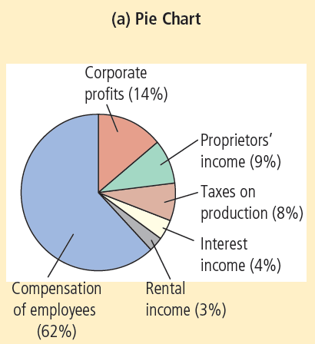
Figure A-1
Types of Graphs (a)
The pie chart in panel (a) shows how the U.S. national income in 2011 was derived from various sources.
© 2015 Cengage Learning. All Rights Reserved. May not be copied, scanned, or duplicated, in whole or in part, except for use as permitted in a license distributed with a certain product or service or otherwise on a password-protected website for classroom use.

Slide 31
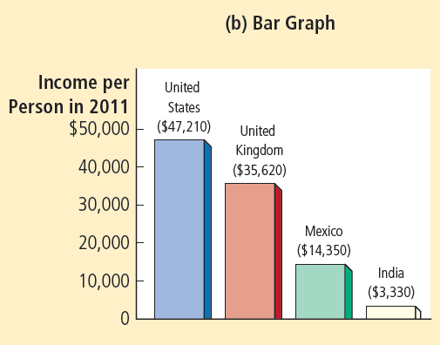
Figure A-1
Types of Graphs (b)
The bar graph in panel (b) compares the 2011 average income in four countries.
© 2015 Cengage Learning. All Rights Reserved. May not be copied, scanned, or duplicated, in whole or in part, except for use as permitted in a license distributed with a certain product or service or otherwise on a password-protected website for classroom use.

Slide 32
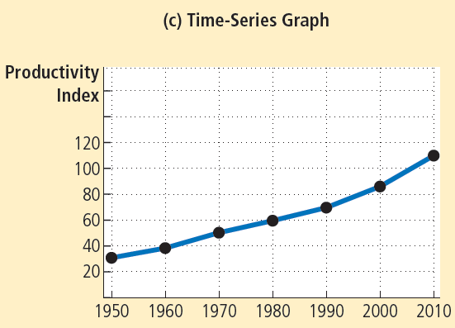
Figure A-1
Types of Graphs (c)
The time-series graph in panel (c) shows the productivity of labor in U.S. businesses from 1950 to 2010.
© 2015 Cengage Learning. All Rights Reserved. May not be copied, scanned, or duplicated, in whole or in part, except for use as permitted in a license distributed with a certain product or service or otherwise on a password-protected website for classroom use.

Slide 33
Graphing: a brief review
Graphs of two variables: the coordinate system
  Display two variables on a single graph
  Scatterplot
  Ordered pairs of points
    x-coordinate
      Horizontal location
    y-coordinate
      Vertical location
© 2015 Cengage Learning. All Rights Reserved. May not be copied, scanned, or duplicated, in whole or in part, except for use as permitted in a license distributed with a certain product or service or otherwise on a password-protected website for classroom use.

Slide 34
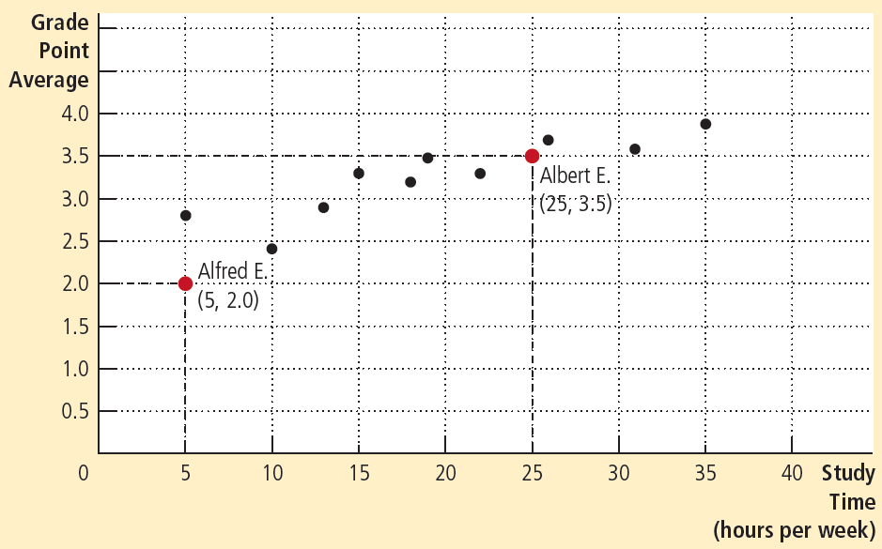
Figure A-2
Using the Coordinate System
Grade point average is measured on the vertical axis and study time on the horizontal axis. Albert E., Alfred E., and their classmates are represented by various points. We can see from the graph that students who study more tend to get higher grades.
© 2015 Cengage Learning. All Rights Reserved. May not be copied, scanned, or duplicated, in whole or in part, except for use as permitted in a license distributed with a certain product or service or otherwise on a password-protected website for classroom use.

Slide 35
Graphing: a brief review
Curves in the coordinate system
Data
  Number of novels purchased
  Price of novels
  Income
Demand curve
  Effect of a good’s price
  On the quantity of the good consumers want to buy
  For a given income
© 2015 Cengage Learning. All Rights Reserved. May not be copied, scanned, or duplicated, in whole or in part, except for use as permitted in a license distributed with a certain product or service or otherwise on a password-protected website for classroom use.

Slide 36
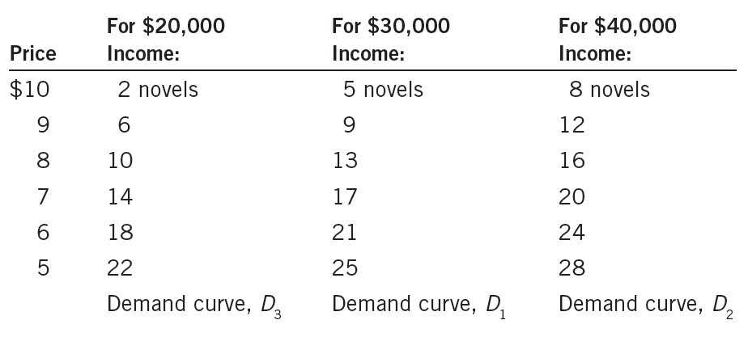
Table A-1
Novels Purchased by Emma
This table shows the number of novels Emma buys at various incomes and prices. For any given level of income, the data on price and quantity demanded can be graphed to produce Emma’s demand curve for novels, as shown in Figures A-3 and A-4.
© 2015 Cengage Learning. All Rights Reserved. May not be copied, scanned, or duplicated, in whole or in part, except for use as permitted in a license distributed with a certain product or service or otherwise on a password-protected website for classroom use.

Slide 37
Graphing: a brief review
Negatively related variables
  The two variables move in opposite direction
  Downward sloping curve
Positively related variables
  The two variables move in the same direction
  Upward sloping curve
Movement along a curve
Shifts in a curve
© 2015 Cengage Learning. All Rights Reserved. May not be copied, scanned, or duplicated, in whole or in part, except for use as permitted in a license distributed with a certain product or service or otherwise on a password-protected website for classroom use.

Slide 38
Figure A-3
Demand Curve
Price of
Novels
$11
10
(5, $10)
9
(9, $9)
8
(13, $8)
7
(17, $7)
6
(21, $6)
5
(25, $5)
4
Demand, D₁
3
2
1
0
5
10
15
20
25
30
Quantity of novels
purchased
The line D₁ shows how Emma’s purchases of novels depend on the price of novels when her income is held constant. Because the price and the quantity demanded are negatively related, the demand curve slopes downward.
© 2015 Cengage Learning. All Rights Reserved. May not be copied, scanned, or duplicated, in whole or in part, except for use as permitted in a license distributed with a certain product or service or otherwise on a password-protected website for classroom use.

Slide 39
Figure A-4
Shifting Demand Curves
Price of
Novels
$11
When income increases, the demand curve shifts to the right.
10
(13, $8)
9
8
(16, $8)
7
(10, $8)
D₂ (income=
$40,000)
6
5
When income decreases, the demand curve shifts to the left.
D₃
(income=
$20,000)
4
D₁
(income=
$30,000)
3
2
1
0
5
10
13
15
16
20
25
30
Quantity of novels purchased
The location of Emma’s demand curve for novels depends on how much income she earns. The more she earns, the more novels she will purchase at any given price, and the farther to the right her demand curve will lie. Curve D₁ represents Emma’s original demand curve when her income is $30,000 per year. If her income rises to $40,000 per year, her demand curve shifts to D₂. If her income falls to $20,000 per year, her demand curve shifts to D₃.
© 2015 Cengage Learning. All Rights Reserved. May not be copied, scanned, or duplicated, in whole or in part, except for use as permitted in a license distributed with a certain product or service or otherwise on a password-protected website for classroom use.

Slide 40
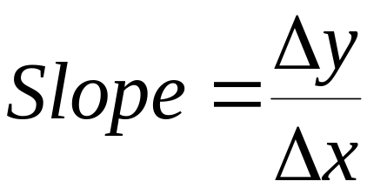
Graphing: a brief review
Slope
  Ratio of the vertical distance covered
  To the horizontal distance covered
  As we move along the line
    Δ (delta) = change in a variable
    The “rise” (change in y) divided by the “run” (change in x).
© 2015 Cengage Learning. All Rights Reserved. May not be copied, scanned, or duplicated, in whole or in part, except for use as permitted in a license distributed with a certain product or service or otherwise on a password-protected website for classroom use.

Slide 41
Graphing: a brief review
Slope
  Fairly flat upward-sloping line
    Slope is a small positive number
  Steep upward-sloping line
    Slope is a large positive number
  Downward sloping line
    Slope is a negative number
  Horizontal line
    Slope is zero
  Vertical line: infinite slope
© 2015 Cengage Learning. All Rights Reserved. May not be copied, scanned, or duplicated, in whole or in part, except for use as permitted in a license distributed with a certain product or service or otherwise on a password-protected website for classroom use.

Slide 42
Figure A-5
Calculating the Slope of a Line
Price of
Novels
$11
10
9
8
(13, $8)
7
6-8=-2
6
(21, $6)
5
21-13=8
4
Demand, D₁
3
2
1
0
5
10
13
15
20
21
25
30
Quantity of novels purchased
To calculate the slope of the demand curve, we can look at the changes in the x- and y-coordinates as we move from the point (21 novels, $6) to the point (13 novels, $8). The slope of the line is the ratio of the change in the y-coordinate (–2) to the change in the x-coordinate (+8), which equals –1⁄4.
© 2015 Cengage Learning. All Rights Reserved. May not be copied, scanned, or duplicated, in whole or in part, except for use as permitted in a license distributed with a certain product or service or otherwise on a password-protected website for classroom use.

Slide 43
Graphing: a brief review
Cause and effect
  One set of events
    Causes another set of events
  Omitted variables
    Lead to a deceptive graph
© 2015 Cengage Learning. All Rights Reserved. May not be copied, scanned, or duplicated, in whole or in part, except for use as permitted in a license distributed with a certain product or service or otherwise on a password-protected website for classroom use.

Slide 44
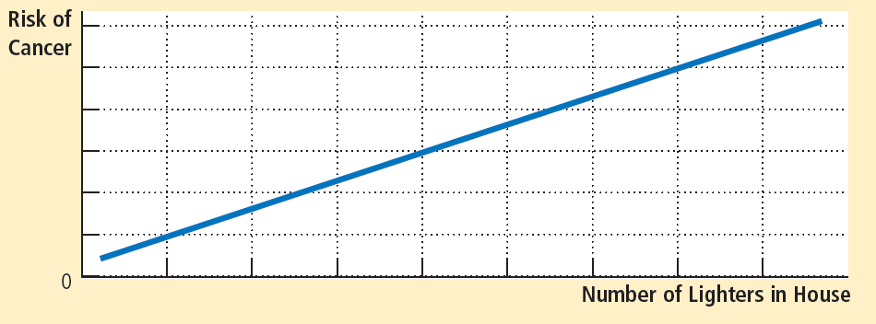
Figure A-6
Graph with an Omitted Variable
The upward-sloping curve shows that members of households with more cigarette lighters are more likely to develop cancer. Yet we should not conclude that ownership of lighters causes cancer because the graph does not take into account the number of cigarettes smoked.
© 2015 Cengage Learning. All Rights Reserved. May not be copied, scanned, or duplicated, in whole or in part, except for use as permitted in a license distributed with a certain product or service or otherwise on a password-protected website for classroom use.

Slide 45
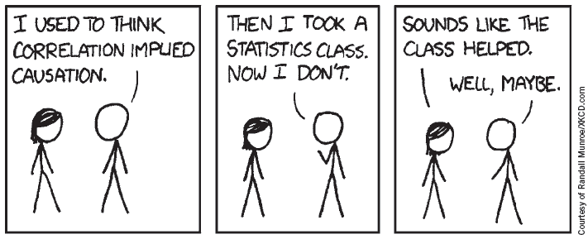
Graphing: a brief review
Cause and effect
  Reverse causality
    Decide that event A causes event B
    Facts: event B causes event A
© 2015 Cengage Learning. All Rights Reserved. May not be copied, scanned, or duplicated, in whole or in part, except for use as permitted in a license distributed with a certain product or service or otherwise on a password-protected website for classroom use.

Slide 46
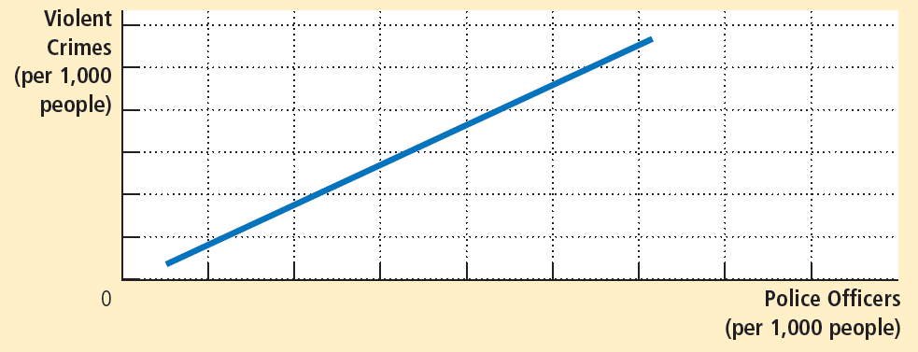
Figure A-7
Graph Suggesting Reverse Causality
The upward-sloping curve shows that cities with a higher concentration of police are more dangerous. Yet the graph does not tell us whether police cause crime or crime-plagued cities hire more police.
© 2015 Cengage Learning. All Rights Reserved. May not be copied, scanned, or duplicated, in whole or in part, except for use as permitted in a license distributed with a certain product or service or otherwise on a password-protected website for classroom use.

